Slide 1
PICCA – A free image processing application
Final Seminar
Btech 451
- Cole Pandya

Slide 2
Seminar schedule
Introduction
Related Work
Project Overview
What makes Picca Different?
Features of Picca
Initial Mock-ups and Final design
Android Application Development
Main filters
Future Work
Conclusion
Application Demo (if any spare time)

Slide 3
Introduction
Earlier Mobile apps: general productivity and retrieval of information
Current Mobile apps: expansion of games and social apps
Rely on smart phones to take pictures than a regular camera
What about editing those images?
My BTech Project – an image processing application for Android devices with screen size of 5” or more
Providing some “popular” functionalities of desktop applications
Image restorations filters will be used to minimize the effect of degradation
Enhancement - involves more extraction of image features
Decision support for filter selection

Slide 4
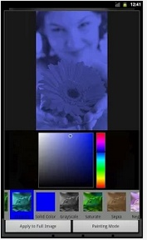
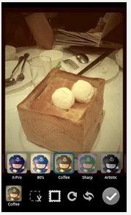
Related Work – popular image processing applications
Photo Art – Colour Effects (right image)
  32 effects - Filters on selected areas of image.
  “Everyone can be an artist!” and photo sharing
Mytubo (bottom right image)
  14 toy camera effects
  Photo sharing
Vignette Demo (Free and paid version)
  84 effects and 54 photo frames.
Image Processing Camera ($1.56)
Photo Editor – Fotolr
  better example of an image processing
Adobe Photoshop Express
  Very basic version
PicsArt
Pixlr-o-matic
And many more...

Slide 5

Project Overview
A free image processing application for the Android tablets
Provided that the image is in the condition to be restored or enhanced
Give users an understanding of the RGB histograms
Check how filter algorithms affect the distribution
20+ Filter effects (more later in the presentation)
Focuses on multiple problems: digital noise, bad exposure, blurry images, and distracting elements etc
My motivation to develop this app was that currently free apps have limited functionalities

Slide 6
What makes Picca different?
Apps like “Photo Art – Colour Effects” or “Mytubo”: no image restoration capabilities or proper image enhancement facilities
‘Artistic effects’ are not be included in Picca.
Vignette Demo provides 80+ effects but all generic filters such as sepia or filters that purposely add noise!
Allows multiple application of filters on one image
Picca consists of filters that are not offered in free apps
Picca focuses mostly on filters and not so much on UI
Picca is free to download
Does not contain photo sharing facility
No basic functions like cropping etc
Many apps available but only a few do the job

Slide 7
Features
Landscape layout: suitable for 5” or more screen
Screens: Homescreen, Filter screen, RGB histograms, Load Images from Gallery GridView.
Camera Package – front and back
Image format: JPEG and 100% quality
Provides PC app features such as Hue, Saturation and Brightness/Value and RGB histograms
Images loaded from a file location using GridView
Save images to gallery
Reset images to original
Re-usability and design of code
Efficient filter algorithms

Slide 8
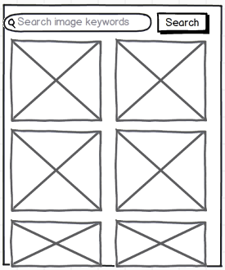
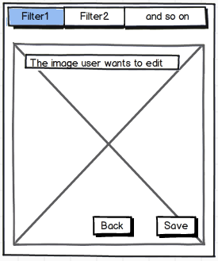
Initial Mock-ups

Slide 9
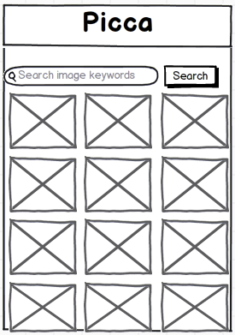
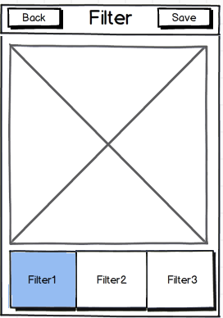
Revised Mock-ups

Slide 10
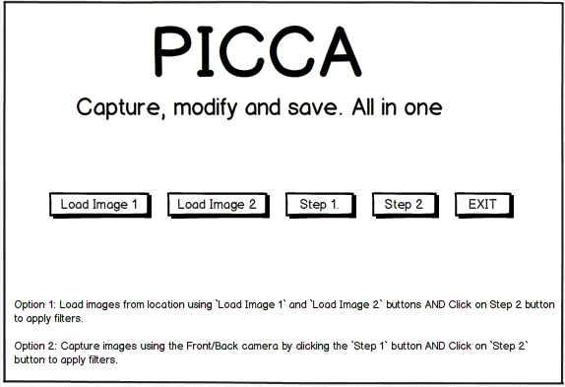
Final Mock-ups: Homescreen

Slide 11
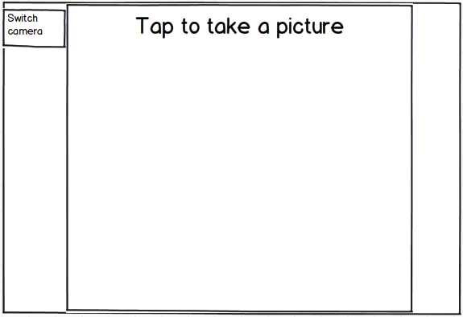
Final Mock-ups: Camera

Slide 12
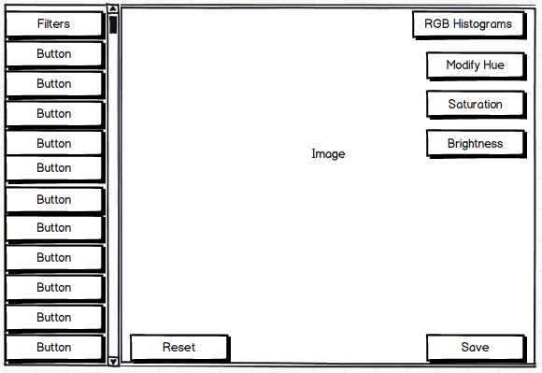
Final Mock-ups: Filter screen

Slide 13
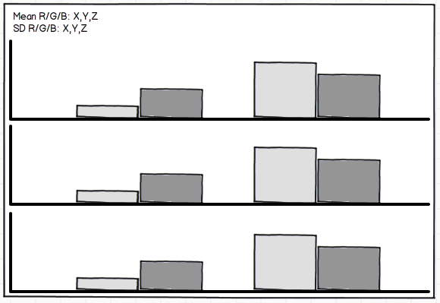
Final Mock-ups: RGB Histograms

Slide 14
Android App development
AndroidManifest.xml: describes the fundamental characteristics of the app and defines each of its components. <uses-sdk android:minSdkVersion=”10" android:targetSdkVersion="17" />
The graphical user interface for an
Android app is built using a hierarchy
of View and ViewGroup objects.
Intent-filters
android:screenOrientation="landscape“
Linear Layout: a view group whose positions of the children can be described in relation to each other or to the parent.
RelativeLayout: similar to LL, encapsulates everything in the layout for my app
ScrollView – vertical scroll view
SurfaceView for RGB histograms – usually used for games and camera related programming

Slide 15
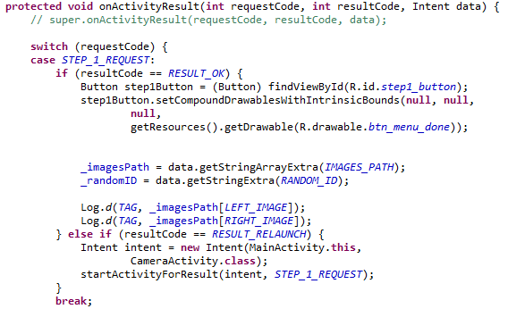
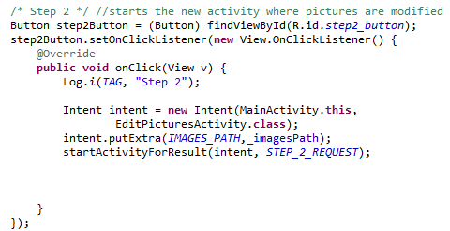
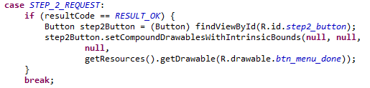
MainActivity
String array _imagesPath is not null if image is taken by the camera.
Using Intents to start activity from MainActivity to CameraActivity and/or EditPicturesActivity
onActivityResult(int requestCode, int resultCode, Intent data)

Slide 16
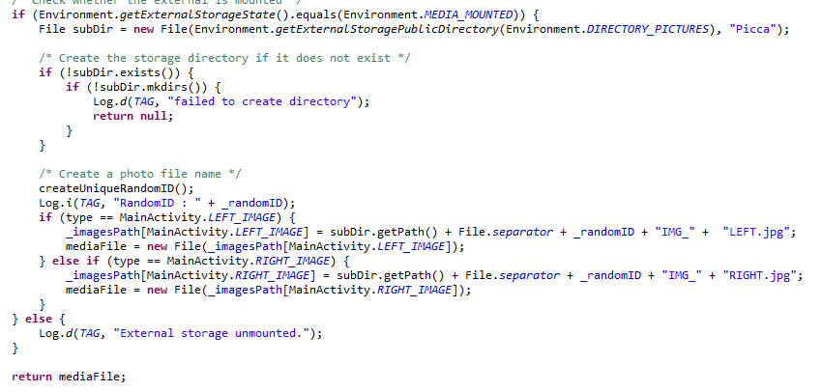
Camera Package – Camera Activity
Captures two images – LeftRightPictureCallback()
Once captured – imageslide is an int – 0 is for LEFT and 1 is RIGHT
Camera check – front/back facing

Slide 17
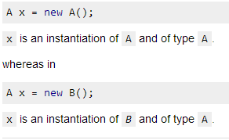
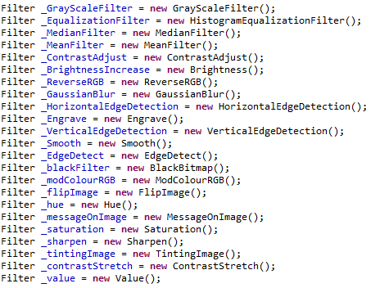
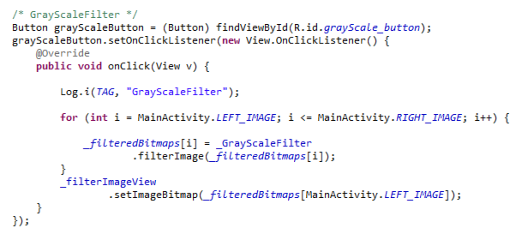
EditPicturesActivity
dynamic binding, as opposed to static binding.

Slide 18
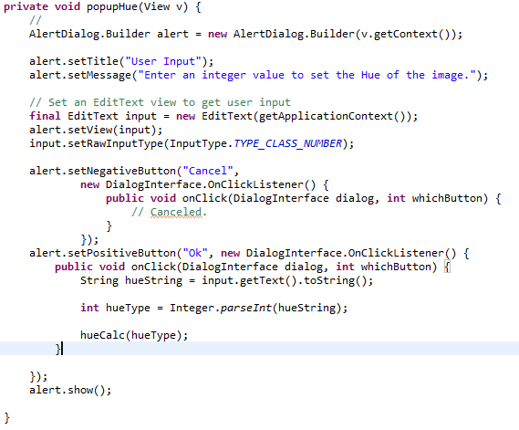

EditPicturesActivity
AlertDialog to gather input from user
Toasts are used to inform user of the input values
Saving Bitmaps using FOS
Restarts the activity using a timer

Slide 19

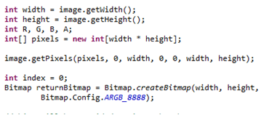

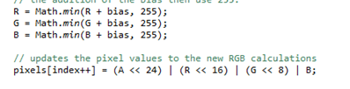
Brightness filter
Creating a bitmap and getting pixels efficiently
ARGB Bitmap Configuration
Each RGB channels modified separately
Need to separate ARGB from pixel value

Slide 20


Contrast Modification
Similar to Brightness modification
Input from user from AlertDialog
Main reasons for acquiring low-contrast images:
  Poor illumination conditions.
  Poor image sensor dynamics.
  Incorrect setting of the lens aperture.

Slide 21
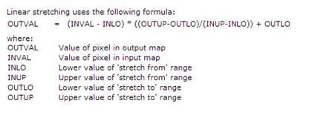
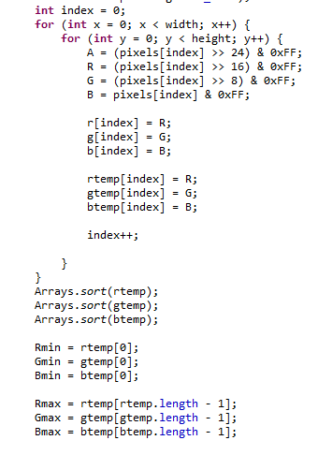

Linear Stretching
improves the brightness differences uniformly and
enhancements improve the brightness differences in the shadow (dark), midtone (grays), or highlight (bright) regions
re-distributes RGB values of an image

Slide 22
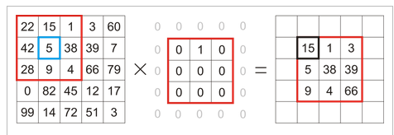

Convolution matrix
Re-usability and design for multiple filters
The filter reads successively, from left to right and from top to bottom, all the pixels of the kernel action area
kernel has to be uneven so that it has a center: eg 3x3, 7x7
New kernels
Factor = denominator and offset = addition or subtraction value

Slide 23
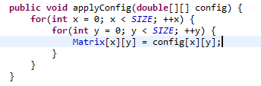
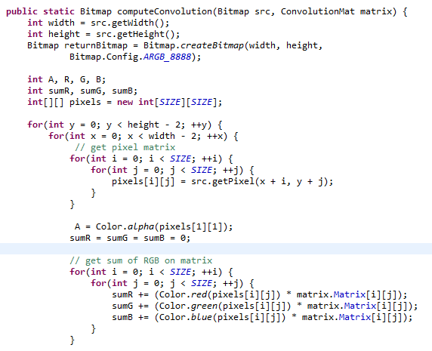
Convolution matrix cont

Slide 24
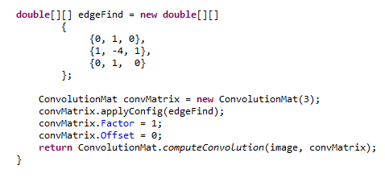
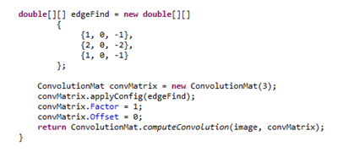
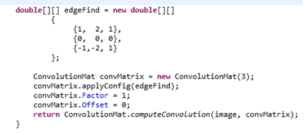
Convolution Matrix – Edge Detection
Edges are significant local changes of intensity in an image
used in many fields such as image processing, machine vision, feature detection and extraction
Can be used by computer vision algorithms, recognition of shapes etc
significantly reduces the amount of data to be processed
Horizontal edge detection
Vertical Edge detection

Slide 25
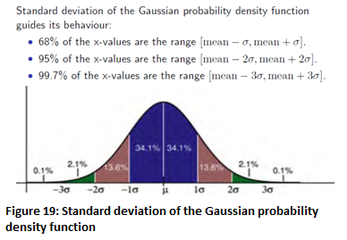
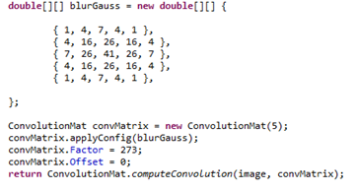
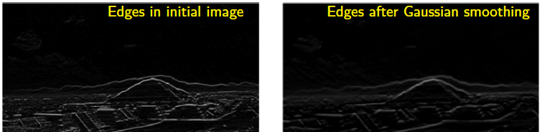
Gaussian Blur using Convolution
it blurs an image by a Gaussian function
size is 5x5 and the Factor value is 273
Image appears slightly darker
reducing the image's high-frequency component; hence a Gaussian blur is thus a low pass filter

Slide 26
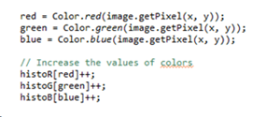

Image/Histogram Equalization
used on images that looks plain and lacks contrast
Available in Photoshop
Different from grayscale images
Used when frequencies lie in the middle or are clustered of the histogram
obtain a uniform histogram
Peaks will still be peaks
Histogram equalization can be done in three steps:
  compute histogram,
  calculate the normalized sum of the histogram,
  transform input image to output image

Slide 27
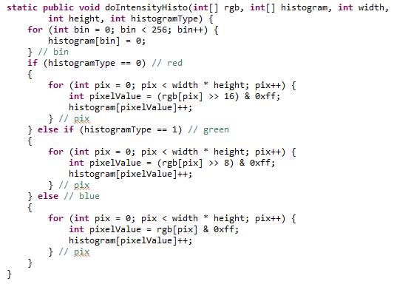
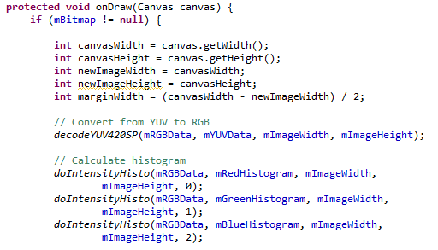
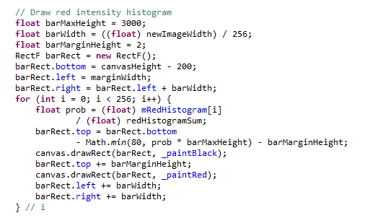
DrawHistograms

Slide 28
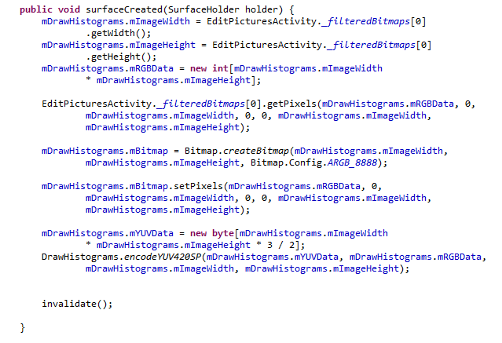
Preview
SurfaceView and SurfaceCallback used with DrawHistograms
Assign the bitmaps and RGB data.
Creating mutable bitmaps
Invalidate just forces the view to restarts

Slide 29
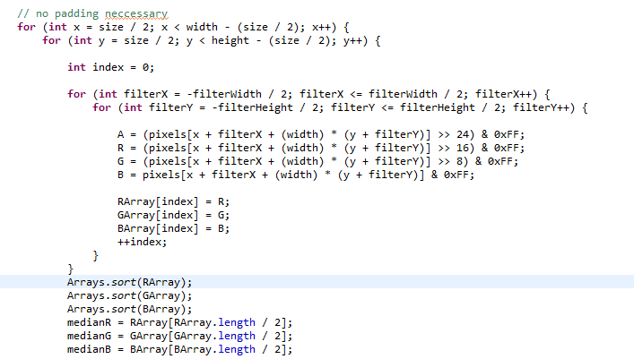
Median Filter
noise reduction: another smoothing filter
moderate level of noise, the median filter is demonstrably better than Gaussian blur
iterate through the image pixels and replacing the pixel values with the median of the neighbouring entries
I have used a box pattern (3x3 square box window)

Slide 30
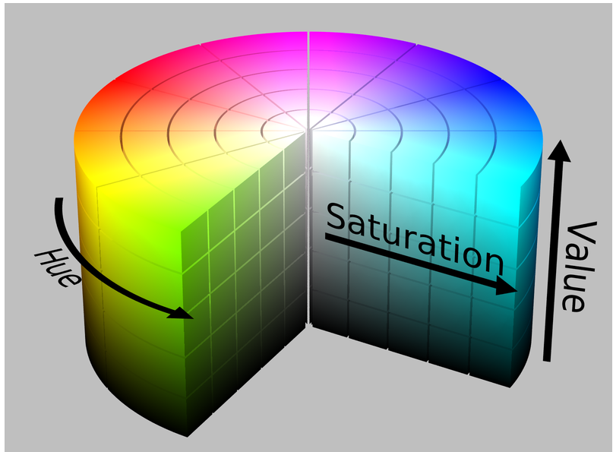
HSV filters
HSV is a common cylindrical-coordinate representations of points in an RGB color model.
Hue, Saturation and Value
Commonly used in Photoshop
Hue ranges from 0 to 360 degrees
Saturation and Value range from 0 to 1.
User controls the HSV level through input

Slide 31
Evaluation
Nielson’s Heuristic Evaluation
  Visibility of system status
  Match between system and the real world
  User control and freedom
  Consistency and standards
  Error prevention
  Recognition rather than recall
  Flexibility and efficiency of use
  Aesthetic and minimalist design
  Help users recognize, diagnose, and recover from errors
  Help and documentation:
Feedback was mostly positive
  Performance – filters like Gaussian blur took a while to apply
  UI needs to have more detail

Slide 32
Conclusion and Future work
Overall, Picca meets the project requirements and provides with image enhancement and restoration support.
successfully process images and also give the user an understanding of the RGB histogram display
For future, optimize layouts according to screen size
Employ third party applications: plug-ins
Android NDK: slight increase in performance
More filters
Improve HCI to attract more users

Slide 33
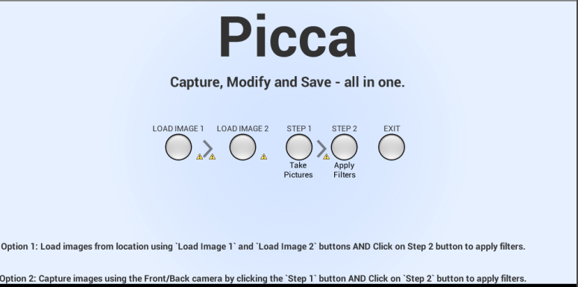
Demo?

Slide 34
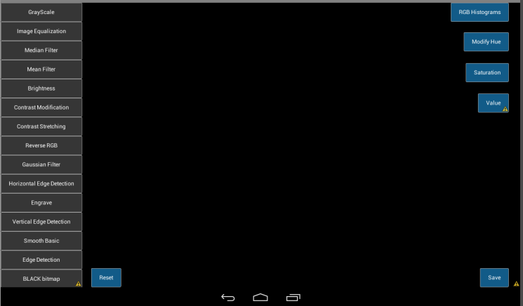
Demo?

